Slide 1
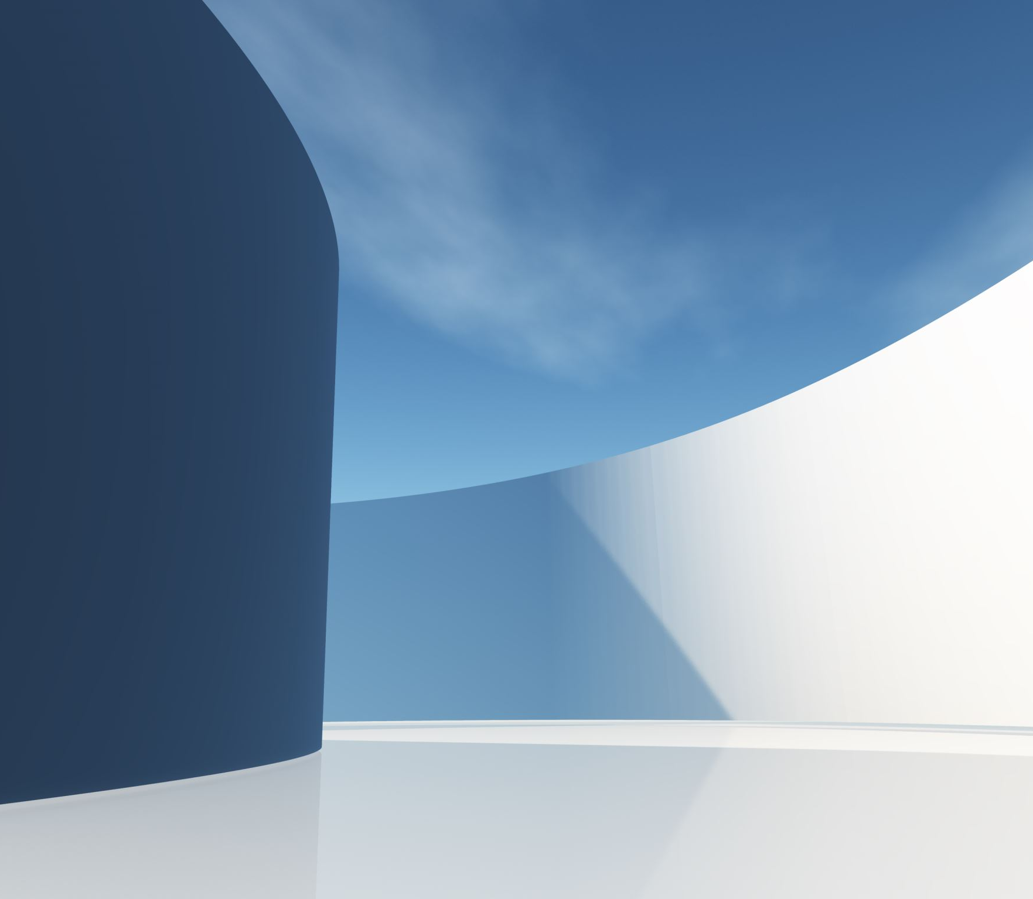
Alzheimer’s Detection Using Deep Learning
Presented by:
Priyanshu Saini
Shreyansh Rai
Guided By:
Mr. Aditya Gupta

Slide 2
Introduction
Alzheimer's disease is a progressive neurodegenerative disorder that affects millions of people worldwide. Early detection and accurate diagnosis of Alzheimer's disease are crucial for better management and treatment outcomes.
Magnetic Resonance Imaging (MRI) is a widely used imaging modality for Alzheimer's disease diagnosis due to its non-invasive nature.
Recent advancements in deep learning techniques have shown promising results in automating the process of MRI image classification for Alzheimer's disease detection. This presentation aims to explore the use of deep learning models for MRI image classification to detect Alzheimer's disease and discuss the potential benefits and limitations of these models.

Slide 3
Problem Statement
Manual interpretation of MRI images is time-consuming, subject to inter-observer variability, and can also lead to misdiagnosis.
Deep learning-based MRI image classification is an emerging approach for AD detection, but there is a need for robust and accurate models that can handle the data imbalance and improve interpretability of the decision-making process.
Therefore, the problem statement is to develop a deep learning model for accurate and automated AD detection using MRI images that can address these challenges and improve patient outcomes.

Slide 4
Research Gap
Limited availability of labeled datasets for training and validating deep learning models for MRI image classification to detect Alzheimer's disease. Most studies in this area have used small or proprietary datasets, which limits the generalizability of the results.
There is a need for larger, diverse, and publicly available datasets that can be used to benchmark different deep learning models for Alzheimer's disease detection.

Slide 5
Research Objectives
To develop a deep learning model for accurate and automated detection of Alzheimer's disease using MRI images.
To evaluate the performance of the developed model on a large dataset of MRI images with four classes (i.e., mild demented, very mild demented, moderate demented, non-demented).
To identify the limitations and potential future directions for improving the performance and interpretability of deep learning-based models for AD detection using MRI images.

Slide 6
Methodology
Data Collection
Data Pre-processing
Model Selection
Model Evaluation
Future Directions

Slide 7
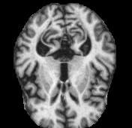
Data Collection
The Kaggle dataset consists of 6400 labeled MRI images. The data has four classes of images both in training as well as a testing set:
Mild Demented
Moderate Demented
Non Demented
Very Mild Demented

Slide 8
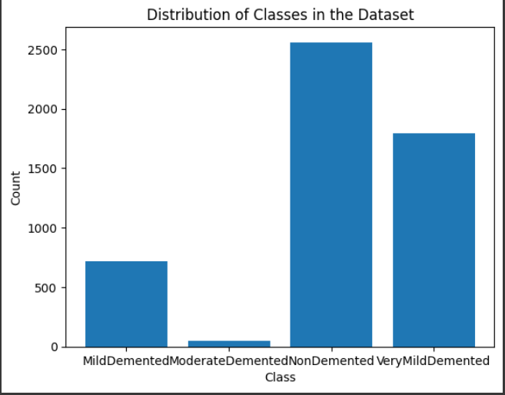
Data Collection
The Kaggle dataset consists of 6400 labeled MRI images. The data has four classes of images both in training as well as a testing set:
Mild Demented
Moderate Demented
Non Demented
Very Mild Demented
Notes:
This chart shows the distribution of the classes in the dataset

Slide 9
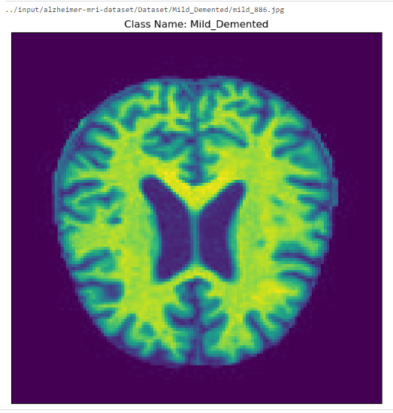
Data Pre-processing
The collected dataset will be pre-processed, which includes resizing, normalization, and augmentation to increase the diversity of the data, to reduce overfitting and to improve the generelisation ability of the model.
Notes:
Resizing: The original images in the dataset have varying sizes. The first step is to resize them to a uniform size to facilitate training. (224,224,3)
Normalization: The pixel values in the images range from 0 to 255. To ensure that the model trains efficiently, it is important to normalize the pixel values to a range between 0 and 1. This is done by dividing each pixel value by 255.
Data augmentation: To prevent overfitting and improve generalization, data augmentation is applied to the images during training.Various types of data augmentation are performed, such as rotation, shearing, zooming, and flipping.

Slide 10
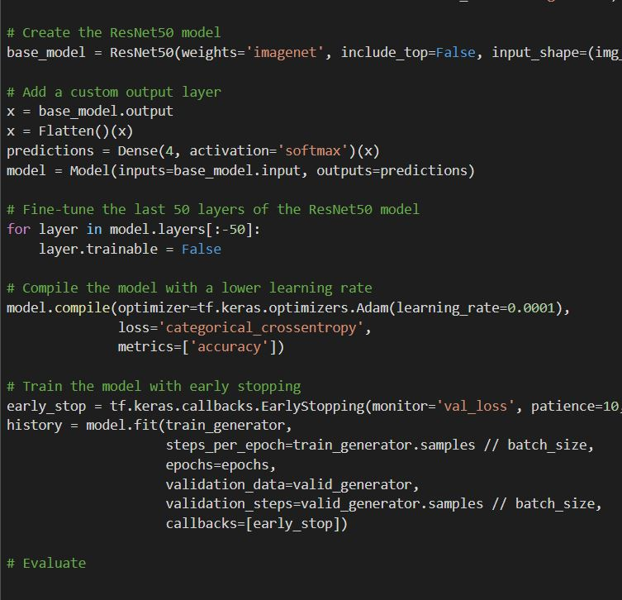
Pre – Trained ResNet50
Notes:
The code imports the ResNet50 model from Keras applications with pre-trained weights on the ImageNet dataset, excluding the top (fully connected) layer, and sets the input shape to (img_height, img_width, 3).
A custom output layer is added to the ResNet50 model, which is a fully connected layer with 4 nodes and a softmax activation function.
The code freezes all layers except the last 50 layers of the ResNet50 model to fine-tune them on the new dataset.
The model is compiled with the Adam optimizer and a learning rate of 0.0001, using categorical cross-entropy as the loss function and accuracy as the metric to evaluate the performance.
Early stopping is implemented with a patience of 10 epochs and the best weights are restored after training.
The model is trained on the training set using a generator with batch size of 32.
The training process is monitored using the validation set and evaluated after each epoch.
The training is stopped early if the validation loss does not improve for 10 epochs.
The code evaluates the trained model on the test set and prints the evaluation metrics.
The trained model and the training history are saved to disk for future use.
In summary, the code fine-tunes the pre-trained ResNet50 model on a new dataset with 4 classes of brain MRI images using transfer learning. The last 50 layers of the ResNet50 model are trained on the new dataset, while the rest of the layers are frozen to avoid overfitting. The model is trained with early stopping to prevent overfitting and evaluated on the test set to measure its performance. Finally, the trained model and the training history are saved for future use.

Slide 11
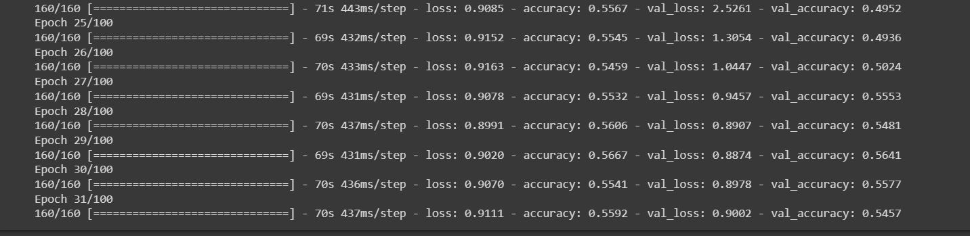
Validation accuracy of 54% and validation loss of 90% was achieved for pre-trained ResNet50 model.

Slide 12
Comparing The Models
Pre-Trained Resnet50 | Pre-Trained VGG16 | Custom-Built CNN
It is trained on millions of images on ImageNet. | Simpler in architecture and easier to train on smaller datasets. | It is built for specific requirements.
It contains 50 convolutional layers and skip connections. | In VGG16 there are thirteen convolutional layers, five Max Pooling layers, and three Dense layers. | In this we built rescaling, convolutional layers, pooling, dropout, flatten, dense layers.
It had a validation accuracy of 54% on our dataset. | It had a validation accuracy of 79% on our dataset. | It had a validation accuracy of 94% on our dataset.
Notes:
Vgg- visual geometry group
Skip connections are a type of shortcut that connects the output of one layer to the input of another layer that is not adjacent to it. Skip connections can help to preserve information and gradients that might otherwise be lost or diluted by passing through multiple layers.
The convolutional layer is the core building block of a CNN,
Max pooling: This works by selecting the maximum value from every pool. Max Pooling retains the most prominent features of the feature map, and the returned image is sharper than the original image.
Dense Layer is simple layer of neurons in which each neuron receives input from all the neurons of previous layer, thus called as dense
Flattening is used to convert all the resultant 2-Dimensional arrays from pooled feature maps into a single long continuous linear vector.

Slide 13
Model Selection
A deep learning-based model will be developed using the TensorFlow-Keras framework. The Custom-Built CNN architecture is developed to handle the four-class classification problem. The model will include convolutional layers, pooling layers, dropout layers, and fully connected layers.

Slide 14
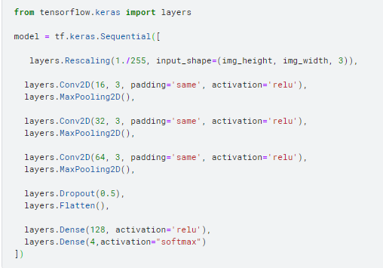
Model Architecture
Notes:
The code imports the 'layers' module from the TensorFlow Keras API. This module contains various neural network layers that can be used to build deep learning models.
The purpose of the Rescaling layer is to normalize the pixel values of the input images to a scale of 0-1. This is done by multiplying each pixel value by a factor of 1/255. This helps the model to converge faster and also improves its performance.
There are three convolutional layers in this model, with filter sizes of 16, 32, and 64 respectively. All the convolutional layers use a filter/kernel size of 3x3 and the 'relu' activation function.
The MaxPooling2D layer reduces the spatial dimensions of the feature maps produced by the convolutional layers. This helps to reduce the computational complexity of the model, and also makes it more robust to small variations in the input images.
The Dropout layer randomly sets a fraction of the input units to zero during training. This helps to prevent overfitting by reducing the co-adaptation of neurons and forcing the network to learn more robust features.
The Flatten layer flattens the output of the convolutional layers into a one-dimensional array, which can then be fed into the fully connected layers of the model. This is necessary because the dense layers only accept one-dimensional input.
There are two dense layers in the model, with 128 and 4 neurons respectively. Both layers use the 'relu' activation function. The rectified linear activation function or ReLU for short is a piecewise linear function that will output the input directly if it is positive, otherwise, it will output zero.
The final activation function of the output layer is 'softmax', which is used for multi-class classification problems. It normalizes the output of the model to a probability distribution over the different classes.
There are no callbacks or optimizers being used in this code.
The model can be trained and evaluated using a dataset by first defining the batch size, number of epochs, and validation split. Then, the model can be compiled with a loss function and optimizer, and fit to the training data using the 'fit' method. Finally, the model can be evaluated on the test data using the 'evaluate' method.

Slide 15
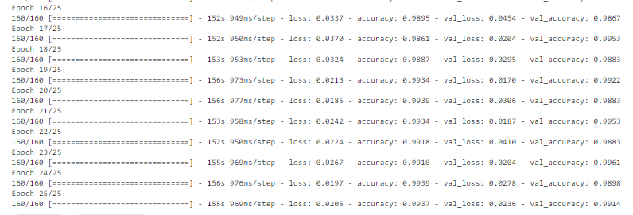
Model Evaluation
Validation accuracy of 99.14% and Validation loss of 2.36% is recorded.

Slide 16
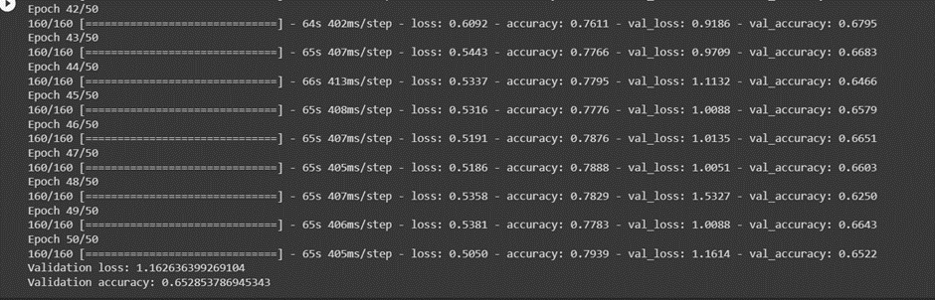
VGG -16
It ran for 50 epochs reaching a validation accuracy of 65.22%.
Notes:
Batch size is a term used in machine learning and refers to the number of training examples utilized in one iteration.

Slide 17
Future Plan and Scope
The limitations of the developed model will be identified, and potential future directions for improving the performance and interpretability of the model for AD detection using MRI images will be discussed.
The future plan for this research includes further validation and refinement of the model by choosing optimal hyperparameters.
Introducing some changes in the model layers’ structure for more efficiency.

Slide 18
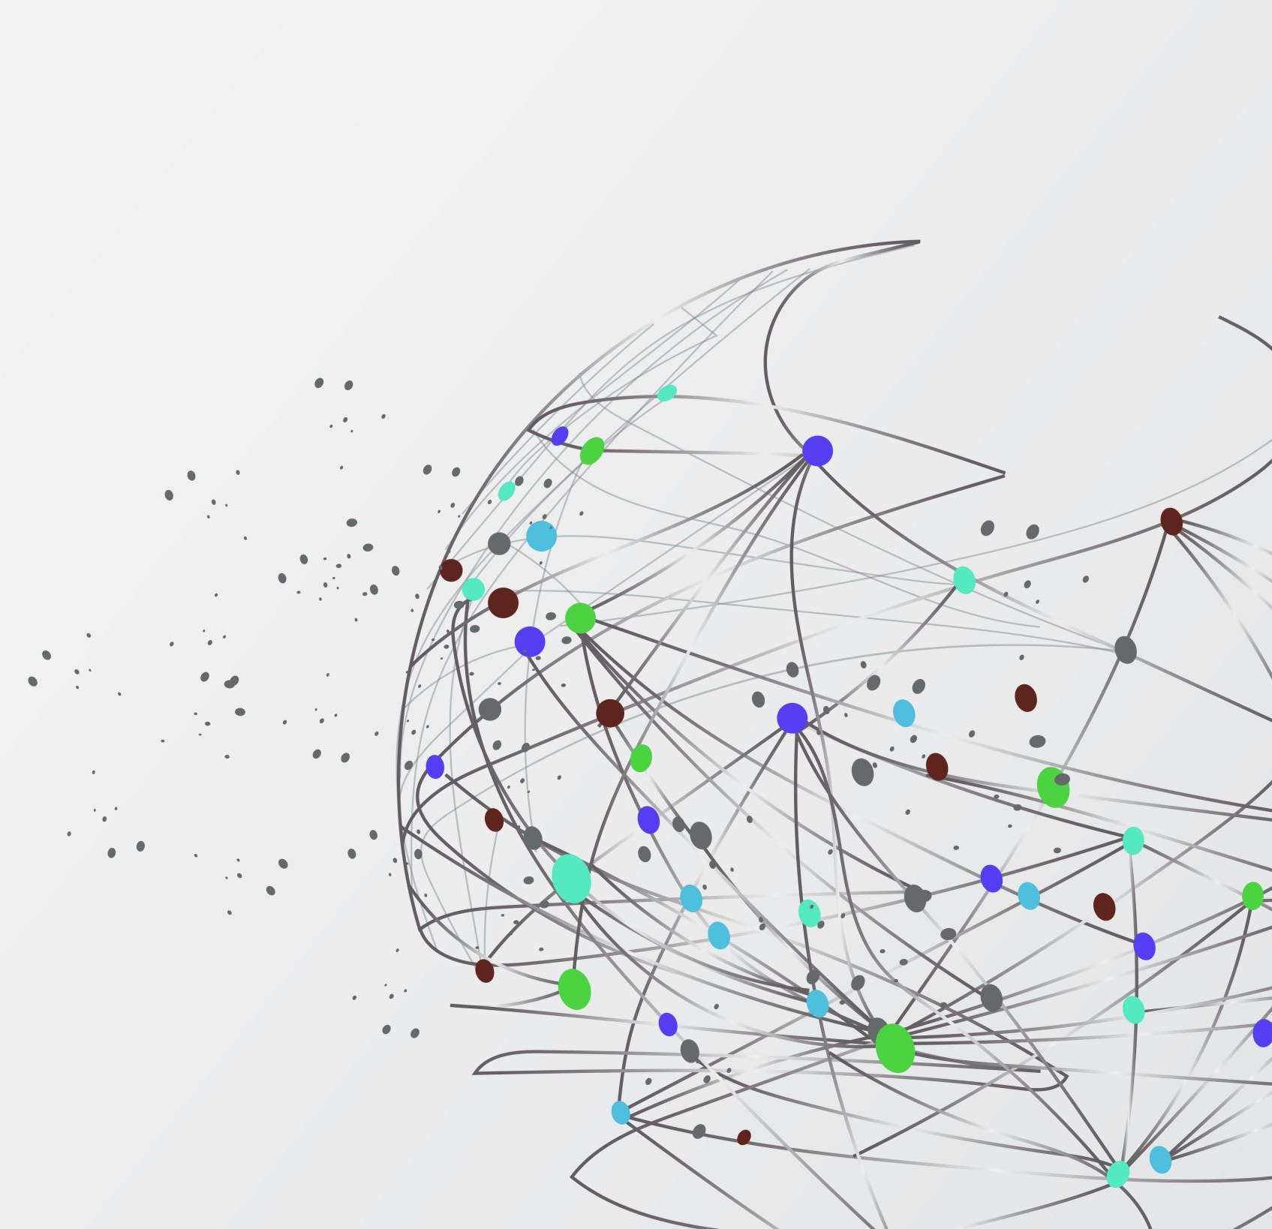
THANK YOU

